Slide 1
Climate change social media analysis

Slide 2
Aims and motives
The aim of this project is to analyze a social media database containing various comments about climate change and people's responses to these comments.
Sentiment Analysis: Gauge public opinion on climate change and NASA's communication strategies.
Trend Analysis: Identify shifts in public sentiment over the specified period.
Engagement Analysis: Understand the correlation between the content of a post and user engagement.
Topic Modeling: Discover prevalent themes in public discourse about climate change.

Slide 3
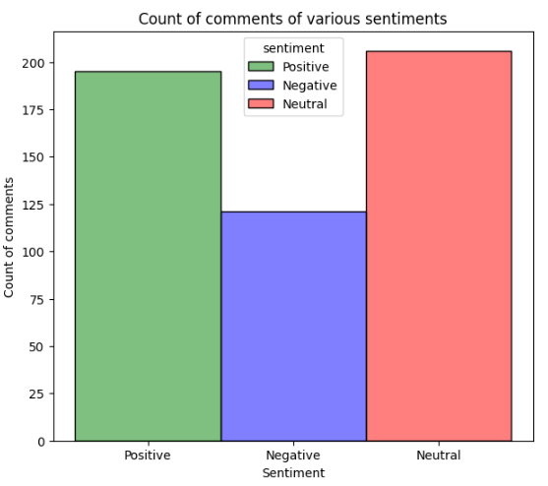
Count of comments of various sentiments
The highest number of comments are of a neutral sentiment =200
Comments having a negative sentiment are the lowest in number=120
Comments having a positive sentiment are the lowest in number =190

Slide 4
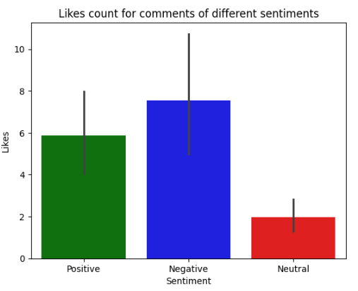
Likes count for different sentiments
The average number of likes received by negative comments (≈7).
The average number of likes received by positive comments (≈6)
The average number of likes received by neutral comments are≈2
Negative comments receive more likes than positive and neutral comments.

Slide 5
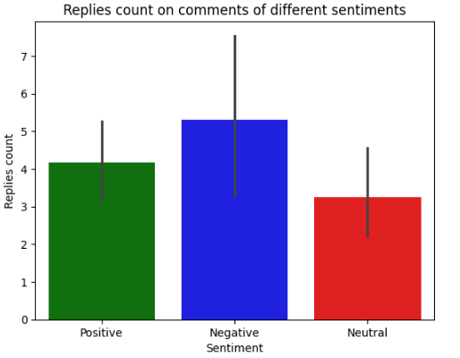
Replies count on different comments
Negative comments receive more replies than positive and neutral comments
Negative comments receive higher engagement than the rest
Neutral comments receive the least replies.

Slide 6
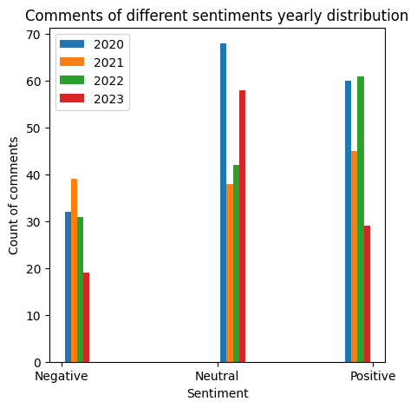

Slide 7
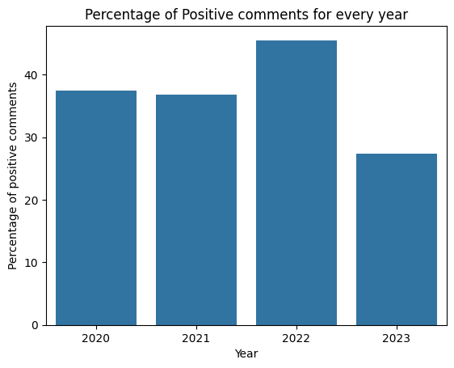
Percentage of positive comments for every year
The percentage positive comments is highest for 2022 and lowest for 2023

Slide 8
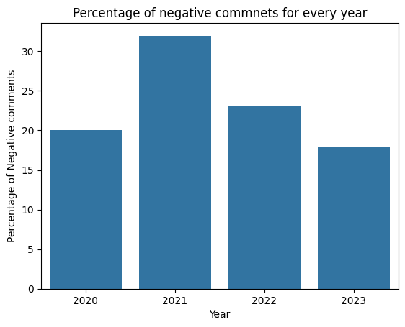
Percentage of negative comments for every year
The percentage negative comments are the highest for 2021 and the lowest for 2023.

Slide 9
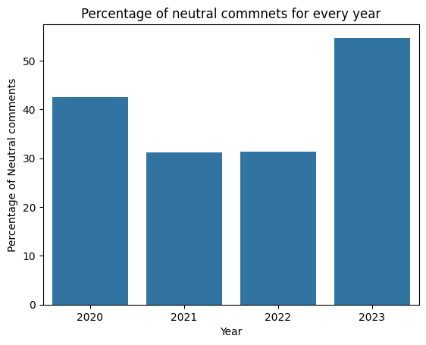
Percentage of positive comments for every year
The percentage of neutral comments is the highest for 2023 and the lowest for 2022 and 2021.

Slide 10
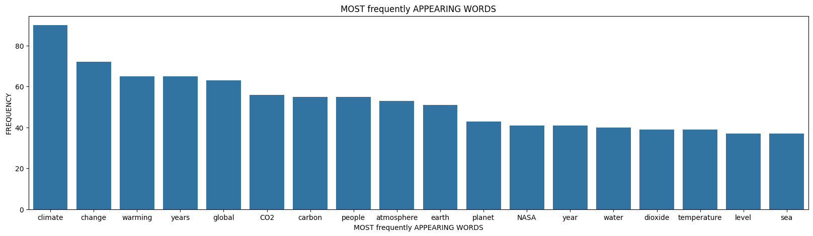
Most commonly used words

Slide 11
Conclusions
The highest number of comments are of a neutral sentiment and comments having a negative sentiment are the lowest in number.
The average number of likes received by negative comments are significantly higher
Negative comments receive more likes than positive and neutral comments
.Negative comments receive more replies than positive and neutral comments
Negative comments receive higher engagement than the rest
The percentage positive comments is highest for 2022 and lowest for 2023
The percentage negative comments are the highest for 2021 and the lowest for 2023
The percentage of neutral comments is the highest for 2023 and the lowest for 2022 and 2021
The most frequently used words are climate ,change ,warming ,years and global.

Slide 12
Thank You

